Slide 1
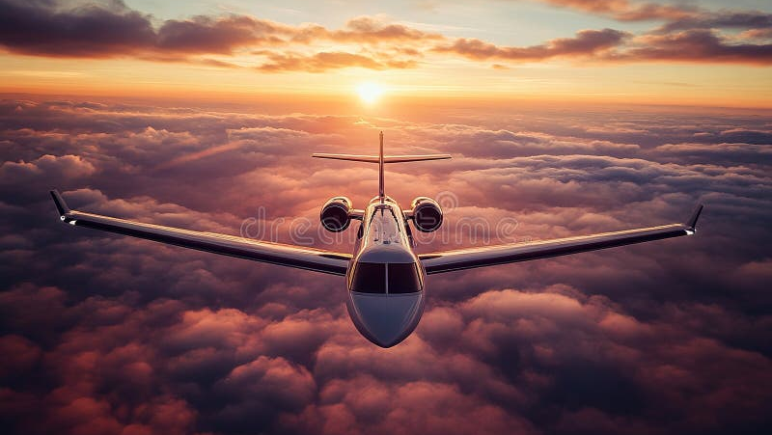
GRADUATION PROJECT 2026
SkyScan
EVERY DESTINATION, ONE SEARCH
Fly Beyond Time & Sky
skyscan.runasp.net

Slide 2

JOURNEY MAP
What's Inside
01
The Story
08
Target Users
02
The Problem
09
Competitive Analysis
03
Our Solution
10
Technology
04
Product Overview
11
Security & Reliability
05
Core Features
12
Future Roadmap
06
Live Demo
13
Lessons Learned
07
Business Model
14
Vision
SkyScan 2026

Slide 3

01
CHAPTER ONE
The Story
Every journey begins with a problem

Slide 4
SkyScan
THE STORY
Meet Sarah
12
Sarah is planning a trip from Cairo to London.
She opens 12 different tabs across airline websites, OTAs, and meta-search engines.
Prices range from $485 to $1,240 for the same route.
She bookmarks three options and plans to decide tomorrow.
By morning, two of those prices have increased.
Sarah's story is not unique.
It happens to millions of travelers every single day.
Websites opened to compare one flight
$755
Price difference for the same route
67%
Of travelers worry they paid too much
01 / The Story

Slide 5
SkyScan
THE STORY
The Traveler's Dilemma
Fragmentation
Price Volatility
Time Wasted
Dozens of booking sites with different interfaces, prices, and hidden fees
Fares change up to 70 times before departure. Dynamic pricing creates anxiety
4.5 hours spent researching flights for a single trip on average
4.5 Hours
Average time spent researching a single trip
"The promise of 'best price' rarely delivers."
01 / The Story

Slide 6
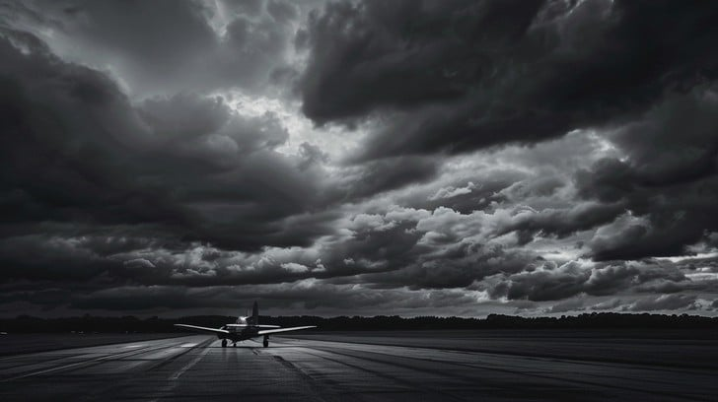
02
CHAPTER TWO
The Problem
Why flight search is broken

Slide 7
SkyScan
THE PROBLEM
Fragmentation Overload
The flight booking industry is hopelessly fragmented.
Travelers must visit 4-7 different websites before making a decision.
Each site has a different interface, filters, and final prices.
The Booking Maze
Airlines sell directly with limited comparison
OTAs add markups and push their own inventory
Meta-search engines show prices rarely bookable
Travelers are left navigating the chaos alone
500+
100s
4-7
Airlines selling tickets directly
OTAs with different markups
Sites visited per booking
02 / The Problem

Slide 8
SkyScan
THE PROBLEM
The Price Volatility Trap
70x
What Affects Prices
● Search demand and booking velocity
How many times a fare changes before departure
● Day of week and time of search
Dynamic pricing algorithms adjust fares based on demand, browsing history, and device type.
A fare seen in the morning can be gone by afternoon.
Travelers have no way to track these changes.
● Device type and browsing history
● Competitor pricing in real-time
● Seasonal trends and events
Result: Anxiety, overpayment, missed deals
02 / The Problem

Slide 9
SkyScan
THE PROBLEM
The Forgotten Journey
38%
Gate Changes
Last-minute changes leave travelers scrambling
Of travelers forget to check booking details
Schedule Shifts
Gate changes go unnoticed. Departure time shifts are missed.
Travelers arrive at the wrong terminal or miss their flight entirely.
Without proactive reminders, the responsibility falls entirely on the traveler.
Departure delays disrupt entire travel plans
Missed Flights
Costly rebooking fees and ruined itineraries
02 / The Problem

Slide 10
SkyScan
THE PROBLEM
Time Is the Real Cost
$2,500+
True annual cost of flight search per frequent traveler
Business travelers book 20+ trips per year.
90 hours lost to flight search alone.
The industry optimized for choice, not efficiency.
02 / The Problem

Slide 11
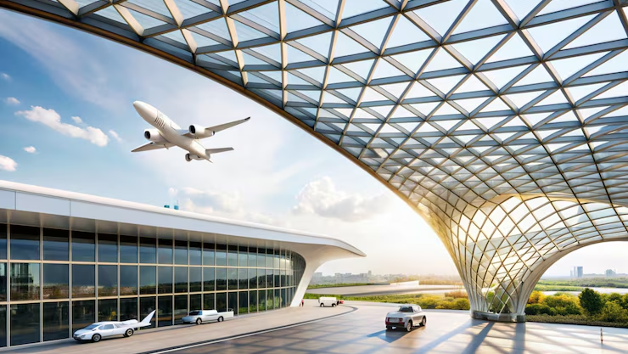
03
CHAPTER THREE
Our Solution
One platform. One search. Complete clarity.

Slide 12
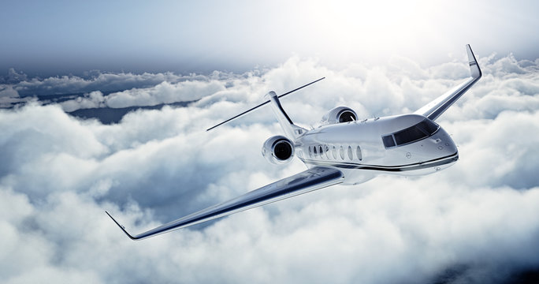
SkyScan
OUR SOLUTION
Introducing SkyScan
SkyScan is a premium flight search platform designed to eliminate the chaos of flight booking.
We do not sell flights. We do not add markups.
We simply help travelers find the best flight options in the simplest way possible.
Clean interface. Real comparisons. Zero confusion.
Simple
Fast
Focused
Reliable
Four fields to search. No clutter.
Results in seconds, not minutes.
One thing done exceptionally well.
Transparent, always available.
03 / Our Solution

Slide 13
SkyScan
OUR SOLUTION
Our Philosophy
"
CLARITY
FOCUS
TRUST
SPEED
ELEGANCE
We believe flight search should be effortless.
No clutter. No noise. No overwhelming options.
Just a clean, elegant interface that shows travelers exactly what they need.
We focus on one thing and we aim to do it better than anyone else.
Simplicity is not a limitation. It is our superpower.
03 / Our Solution

Slide 14
04
CHAPTER FOUR
Product Overview
See SkyScan in action

Slide 15
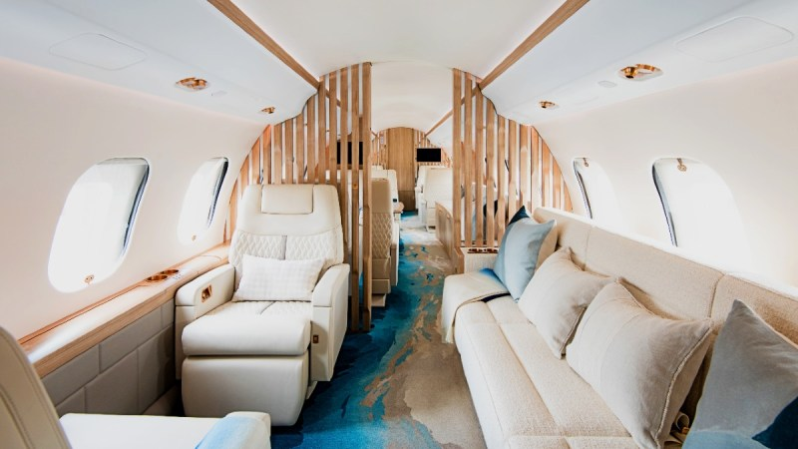
SkyScan
PRODUCT OVERVIEW
The SkyScan Experience
Dark Immersive UI
Inspired by the night sky. Easy on the eyes, premium in feel.
Glassmorphism Cards
Frosted glass elements float above stunning aviation imagery.
Gold Accents
Champagne gold guides the eye to what matters most.
Adaptive Design
The interface adapts to the traveler, not the other way around.
04 / Product Overview

Slide 16
SkyScan
PRODUCT OVERVIEW
Home Screen
● ● ●
skyscan.runasp.net
SkyScan
A cinematic full-screen view of a private jet against dramatic clouds.
The search form floats in a frosted glass card.
Origin, destination, date, cabin class. Four fields.
No registration required. No popups. No distractions.
EVERY DESTINATION, ONE SEARCH
SEARCH FLIGHTS
FROM
Origin City...
TO
Destination City...
DEPARTURE
CABIN CLASS
07/10/2026
Economy
SEARCH FLIGHTS →
04 / Product Overview

Slide 17
SkyScan
PRODUCT OVERVIEW
Search Results
Results appear as elegant flight cards on a dark canvas.
Each card shows airline, times, duration, stops, and price.
Fastest Route badges highlight the best options.
Egyptair
11:05 → 15:30
FASTEST
$148
CAI ✈ AUH | 4h 25m | Non-stop
Egyptair
23:45 → 04:05
$150
CAI ✈ AUH | 4h 20m | Non-stop
Saudi Arabian Airlines
04:45 → 14:05
$152
CAI ✈ AUH | 9h 20m | 1 Stop
04 / Product Overview

Slide 18

05
CHAPTER FIVE
Core Features
Built for travelers, designed for clarity

Slide 19
SkyScan
CORE FEATURES
01
Flight Search
Search flights across 5,000+ airports worldwide.
Enter origin and destination, select your date, choose cabin class.
SkyScan queries multiple flight data sources for comprehensive results.
One search. All options. No more tab switching.
One Search. All Options.
No more opening multiple tabs. No more comparing across sites. SkyScan aggregates everything in one elegant interface.
5,000+
<3s
Airports worldwide in our database
Average search response time
4 FIELDS | 1 CLICK | ALL RESULTS
05 / Core Features

Slide 20
SkyScan
CORE FEATURES
02
Flight Comparison
Compare flights side-by-side with clear, consistent formatting.
Price, duration, stops, airline, and times displayed uniformly.
No hidden fees. No surprises.
Airline | Departs | Arrives | Duration | Stops | Price | Badge
Egyptair | 11:05 | 15:30 | 4h 25m | Non-stop | $148 | Fastest
Egyptair | 23:45 | 04:05 | 4h 20m | Non-stop | $150
Saudi Airlines | 04:45 | 14:05 | 9h 20m | 1 Stop | $152
Etihad | 02:25 | 06:55 | 4h 30m | Non-stop | $164
05 / Core Features

Slide 21
SkyScan
CORE FEATURES
03
Smart Redirect
When travelers find their perfect flight, SkyScan redirects them to the booking provider.
We do not handle payments. We do not store card details.
We connect travelers to the best options with a single click.
Why This Matters
● No payment processing risk
● No card data stored
● Book with trusted airlines directly
Find Flight
Click Details
Redirect
Book on Airline Site
Transparent | Secure | Simple
05 / Core Features

Slide 22
SkyScan
CORE FEATURES
04
Price Drop Notifications
From: SkyScan Alerts
Subject: Price Drop Alert - Cairo to London
Travelers can track flights and receive automatic email alerts when prices drop.
Set your target route, and SkyScan monitors fare changes around the clock.
Never miss a better deal. Never overpay again.
SkyScan
Price Drop Alert!
Cairo (CAI) to London (LHR)
Was $485
Now $410
▼ Save $75 (15%)
VIEW FLIGHT
05 / Core Features

Slide 23
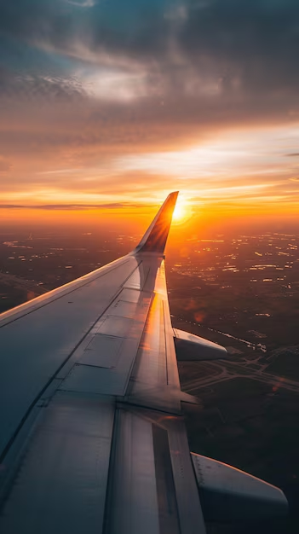
SkyScan
CORE FEATURES
05
Trip Reminder Emails
Automated reminder emails sent before departure.
Flight details, departure time, and airport info delivered to your inbox.
No more forgotten flights. No more missed departures.
SkyScan remembers so you do not have to worry.
24 Hours Before
2 Hours Before
Initial reminder with full flight details and check-in link
Final reminder with gate info and departure countdown
05 / Core Features

Slide 24
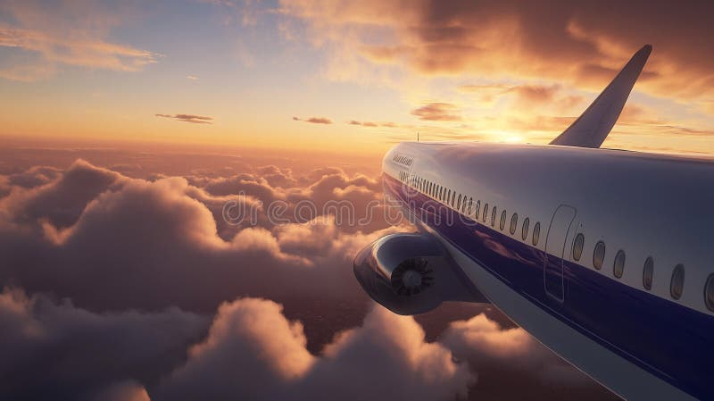
06
CHAPTER SIX
Live Demo
A walkthrough of the SkyScan platform

Slide 25
SkyScan
LIVE DEMO
01
Search
● ● ●
SkyScan
The traveler arrives at skyscan.runasp.net.
A cinematic hero section with a private jet against the clouds.
They enter Cairo as origin, Abu Dhabi as destination.
Select July 10, 2026, Economy class.
One tap on "Search Flights".
EVERY DESTINATION, ONE SEARCH
SEARCH FLIGHTS
FROM
Cairo, Egypt
TO
Abu Dhabi, UAE
DEPARTURE
CABIN CLASS
10 July 2026
Economy
SEARCH FLIGHTS →
06 / Live Demo

Slide 26
SkyScan
LIVE DEMO
02
Browse Results
● ● ●
Cairo to Abu Dhabi
10 July, 2026 | 10 Results Found
10 flight options appear, sorted by relevance.
First option: Egyptair, 11:05-15:30, non-stop, $148.
A "Fastest Route" badge highlights the best.
Filters refine by stops, airlines, or price.
Egyptair
11:05 → 15:30
$148
4h 25m | Non-stop
FASTEST
Egyptair
23:45 → 04:05
$150
4h 20m | Non-stop
Saudi Arabian Airlines
04:45 → 14:05
$152
9h 20m | 1 Stop
06 / Live Demo

Slide 27
SkyScan
LIVE DEMO
03
Select & Redirect
Click "Flight Details" on the preferred option.
Full flight info appears including airport codes and terminals.
A clear CTA redirects to the booking provider.
The booking completes on the airline's trusted platform.
View Details
Review Flight
Click to Book
Book on Airline
SkyScan never touches the payment. Zero financial risk.
06 / Live Demo

Slide 28
SkyScan
LIVE DEMO
04
Stay Informed
After searching, travelers set up price drop alerts for their route.
SkyScan monitors fares and sends an email when prices decrease.
As departure approaches, automated reminders ensure travelers have all details.
Price Drop Alerts
From Search to Departure
Automatic email when fares decrease on tracked routes
SkyScan stays with the traveler
every step of the journey.
Search → Compare → Track → Remind
Trip Reminders
Pre-departure emails with flight details and updates
06 / Live Demo

Slide 29
07
CHAPTER SEVEN
Business Model
How SkyScan generates revenue

Slide 30
SkyScan
BUSINESS MODEL
01
Affiliate Partnerships
SkyScan earns referral commissions when travelers book through partner links.
Airlines and OTAs pay a percentage of each completed booking.
This is the primary revenue stream.
No cost to travelers. No hidden fees.
Win-Win-Win Model
Travelers find the best flights
Partners gain qualified bookings
SkyScan earns commissions
How It Works
1. Traveler searches on SkyScan
2. Clicks through to airline/OTA website
3. Completes booking on partner site
4. SkyScan receives referral commission
REVENUE FROM PARTNERS, NOT USERS
07 / Business Model

Slide 31
SkyScan
BUSINESS MODEL
02
Referral Commissions
Each redirect to a booking provider is tracked through affiliate partnerships.
When a traveler completes a booking, SkyScan receives a commission.
Commission Structure
Economy Class
$4-6 per booking
Premium Economy
$6-8 per booking
Business Class
$10-20 per booking
First Class
$20-50+ per booking
1-3%
$400
Commission rate per booking
Average flight booking value
$4-12
Revenue per successful referral
07 / Business Model

Slide 32
SkyScan
BUSINESS MODEL
03
Travel Partner Integrations
Future partnerships with travel insurance providers, lounge access services, and baggage protection companies. SkyScan can offer travelers additional services at the point of search. Each integration creates a new revenue stream while adding value.
Travel Insurance
Lounge Access
Baggage Protection
Partner integrations at point of search. Commission per policy sold.
Premium lounge passes for frequent flyers. Revenue share model.
Protection plans for checked luggage. Affiliate fee per activation.
All partner integrations are future roadmap items, not currently implemented.
07 / Business Model

Slide 33
SkyScan
BUSINESS MODEL
Revenue Projections
Year 1
Build user base, product-market fit. Minimal revenue focus.
Year 2
Scale partnerships. Target 50K monthly searches. $180K revenue.
Year 3
Expand integrations. 200K monthly searches. $720K revenue.
Year 4+
Premium features, loyalty program. $2M+ annual revenue target.
07 / Business Model

Slide 34
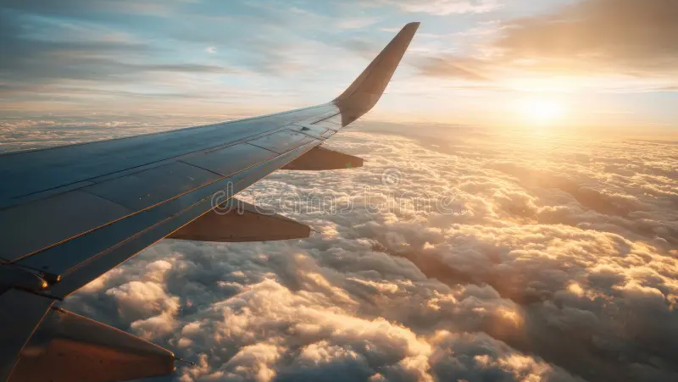
08
CHAPTER EIGHT
Target Users
Who SkyScan is built for

Slide 35
SkyScan
TARGET USERS
01
Students
Budget-conscious travelers who need the lowest fares.
Students book during holidays, semester breaks, and study abroad.
They are price-sensitive but tech-savvy.
SkyScan helps them find affordable options quickly.
Price First
Tech Native
Lowest fare is the top priority
Comfortable with digital tools
08 / Target Users

Slide 36
SkyScan
TARGET USERS
02
Families
Parents booking for multiple passengers need clarity and confidence.
They want the best value, not necessarily the lowest price.
Family travelers appreciate transparent pricing and reliable reminders.
SkyScan removes the stress from family travel planning.
Stress-Free Planning
Reminders keep the family informed.
Price alerts ensure the best deal.
Simple search saves precious time.
Multi-Passenger
Transparency
Booking for the whole family at once
No hidden fees, clear total pricing
08 / Target Users

Slide 37
SkyScan
TARGET USERS
03
Business Travelers
Time is money. Business travelers book frequently and need efficiency.
They value speed, reliability, and clean interfaces.
SkyScan delivers results in seconds, not minutes.
Trip reminders ensure they never miss a meeting flight.
Speed First
Results in under 3 seconds
Professional Grade
Clean, distraction-free interface
90 Hours Saved
Never Miss a Flight
Automated reminders before departure
Per year for frequent business travelers using SkyScan
08 / Target Users

Slide 38
SkyScan
TARGET USERS
04
Tourists & Frequent Flyers
Tourists exploring new destinations need inspiration and comparison tools. Frequent flyers book regularly and want to optimize their travel spending. Both groups benefit from price drop alerts and the simplicity of a single search platform.
Tourists
Shared Benefits
Need inspiration and easy comparison for leisure travel
● Price drop alerts
● Simple single search
● Trip reminders
● Transparent comparisons
Frequent Flyers
Want to optimize spending and track price changes over time
08 / Target Users

Slide 39

09
CHAPTER NINE
Competitive Analysis
How SkyScan stands apart

Slide 40
SkyScan
COMPETITIVE ANALYSIS
The Competitive Landscape
Feature | SkyScan | Skyscanner | Google Flights | Kayak
Interface | Clean, minimal | Cluttered with ads | Functional but busy | Feature-heavy
Price Alerts | Built-in, free | Available | Basic only | Available
Trip Reminders | Automated emails | No | No | Limited
Booking Model | Transparent redirect | Pushes own inventory | Direct booking | OTA-focused
09 / Competitive Analysis

Slide 41
SkyScan
COMPETITIVE ANALYSIS
The SkyScan Advantage
Simplicity First
Focused Features
Price Intelligence
Cleanest interface in the market. No clutter. No ads. Just flights.
Only what travelers actually need. No bloat. No unnecessary extras.
Automated alerts that competitors charge for. Always free.
Trip Support
Transparent Model
Premium Experience
Reminders that keep travelers informed from search to departure.
We do not sell flights. No hidden agenda. No conflict of interest.
Dark, elegant UI that feels like a luxury product, not a utility.
09 / Competitive Analysis

Slide 42

10
CHAPTER TEN
Technology
Built on modern, scalable architecture

Slide 43
SkyScan
TECHNOLOGY
Platform Architecture
User Layer
Responsive web interface with glassmorphism design
Application Layer
SkyScan platform: search, comparison, user management
Data Layer
Flight APIs providing real-time pricing and availability
Notification Layer
Automated email system for price alerts and trip reminders
Booking Layer | Seamless redirect to partner websites
10 / Technology

Slide 44
SkyScan
TECHNOLOGY
Data Flow
Traveler Searches
Query APIs
Process Results
Display to User
Background processes continue after the user leaves:
● Price monitoring for tracked routes
● Email notifications on fare changes
● Trip reminders as departure approaches
Monitor Prices
Redirect to Book
Send Alerts
10 / Technology

Slide 45
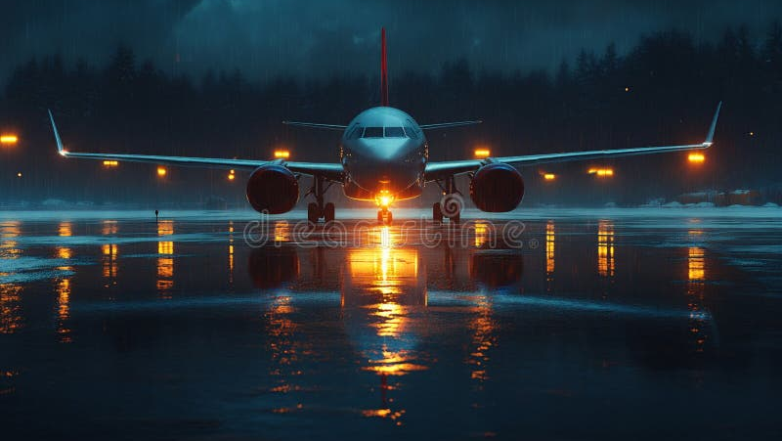
11
CHAPTER ELEVEN
Security & Reliability
Trust is everything

Slide 46
SkyScan
SECURITY & RELIABILITY
Security First
SkyScan does not store payment information. All redirects use HTTPS encryption. User data is protected with industry-standard security practices.
The safest transaction is the one we do not handle.
Our Security Promise
● No financial data collected
● HTTPS on all connections
● Industry-standard practices
● Transparent data handling
No Payment Data
HTTPS Encryption
We never store card details or process payments
All redirects and data transfers are encrypted
11 / Security & Reliability

Slide 47
SkyScan
SECURITY & RELIABILITY
Reliability & Availability
99.9%
Reliability Stack
Uptime SLA commitment
● Cloud infrastructure
● 99.9% uptime SLA
● Auto-scaling capabilities
● Redundant API connections
● Database backups
● Disaster recovery protocols
● Always there when needed
Cloud Infrastructure
Auto-scaling handles traffic spikes during peak seasons
Redundant APIs
Multiple data sources ensure search results are always available
11 / Security & Reliability

Slide 48
SkyScan
SECURITY & RELIABILITY
Scalability
Microservices architecture allows independent scaling of search, notification, and user management components.
Caching layers reduce API costs and improve response times.
Scaling Strategy
● Microservices architecture
● Independent component scaling
● Multi-layer caching
● From 100s to millions of searches
● No architectural changes needed
● Cost-optimized API usage
11 / Security & Reliability

Slide 49

12
CHAPTER TWELVE
Future Roadmap
Where SkyScan is headed

Slide 50
SkyScan
FUTURE ROADMAP
01
Phase 1: Foundation
Q1 - Q2 2026
Core Flight Search
Price Drop Alerts
Trip Reminders
Search and comparison engine
Email notifications for fare changes
Pre-departure email system
Affiliate Partnerships
User Feedback Loop
Integration with airlines and OTAs
Collect feedback and iterate rapidly
IN PROGRESS
12 / Future Roadmap

Slide 51
SkyScan
FUTURE ROADMAP
02
Phase 2: Intelligence
Q3 - Q4 2026
AI Recommendations
Price Prediction
Multi-City Search
Personalized flight suggestions
Advise optimal booking timing
Complex itinerary support
Progressive Web App
Mobile-responsive PWA for on-the-go flight search
PLANNED
12 / Future Roadmap

Slide 52
SkyScan
FUTURE ROADMAP
03
Phase 3: Expansion
2027 and Beyond
Native Mobile Apps
Loyalty Program
Carbon Footprint Filter
iOS and Android applications
Partner airlines and OTAs rewards
Eco-conscious travel options
Ancillary Services
Global Expansion
Insurance, baggage, lounge integrations
Localized interfaces for international markets
VISION
12 / Future Roadmap

Slide 53

13
CHAPTER THIRTEEN
Lessons Learned
Growth through building

Slide 54
SkyScan
LESSONS LEARNED
01
Technical Growth
Building SkyScan required integrating multiple third-party APIs with different data formats and response times.
We learned the importance of robust error handling, caching strategies, and graceful degradation.
Every API failure is an opportunity to build a more resilient system.
"Every bug taught us something new."
Technical skills grow fastest when solving real problems.
API Integration
Error Resilience
Mastered working with diverse data formats and unreliable external services
Built fallback systems that keep working even when dependencies fail
13 / Lessons Learned

Slide 55
SkyScan
LESSONS LEARNED
02
Business Thinking
A great product is not enough. Understanding the business model, identifying revenue streams, and building partnerships are equally critical.
We learned to think beyond features and focus on value creation for both users and partners.
Key Insight
Technology enables business.
Business drives impact.
Both must work together.
Product-Market Fit
Revenue Mindset
Building what users actually need, not what we think they want
Every feature should contribute to sustainable business growth
13 / Lessons Learned

Slide 56
SkyScan
LESSONS LEARNED
03
Problem Solving & Collaboration
Every bug taught us something new. Every user feedback session revealed blind spots. Working as a team meant combining technical skills with design sensibility and business acumen. The best solutions emerged from diverse perspectives and relentless iteration.
Team Collaboration
Iteration
User Feedback
Diverse skills coming together. Developers, designers, and business thinkers united.
Build, test, learn, repeat. Each cycle produced a better product than the last.
Listening to real users shaped our roadmap more than any internal plan.
13 / Lessons Learned

Slide 57
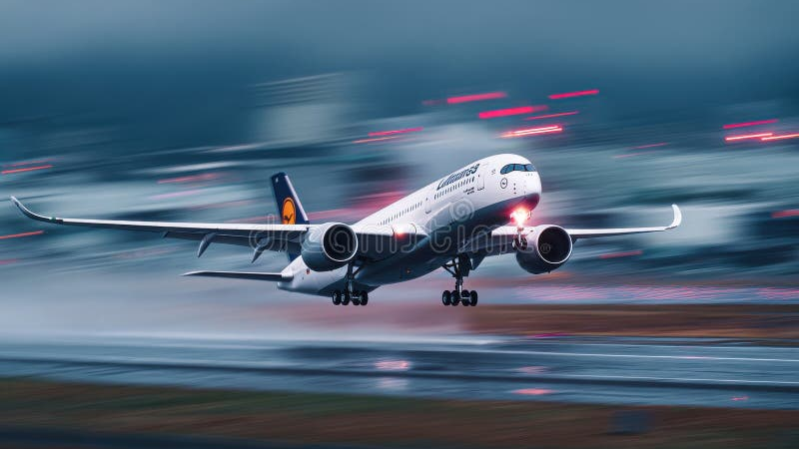
14
CHAPTER FOURTEEN
Vision
The future of flight search

Slide 58
SkyScan
VISION
Our Mission
"
SIMPLICITY
CLARITY
TRUST
FOCUS
EXCELLENCE
SkyScan exists to make flight search effortless.
In a world of overwhelming choices, we choose focus over features.
We believe travelers deserve a tool that respects their time and intelligence.
One search. Clear results. Zero stress.
That is the SkyScan promise.
14 / Vision

Slide 59
SkyScan
VISION
The Sky Ahead
1 Billion+
Annual flight searches worldwide
The global flight search market is massive. Yet travelers remain frustrated.
SkyScan sees an opportunity to do one thing exceptionally well.
We are not building another super-app.
We are building the best flight search experience in the world.
Our North Star
One problem.
One solution.
Exceptional execution.
14 / Vision

Slide 60
THANK YOU
SkyScan
EVERY DESTINATION, ONE SEARCH
Questions & Discussion
skyscan.runasp.net
Graduation Project 2026

